Slide 1
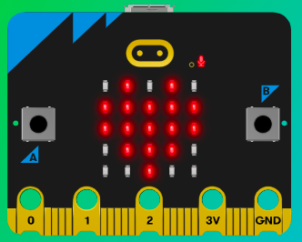
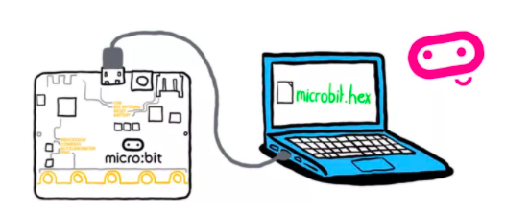
MicroMakers!
KIDS’ MAKER CLUB OF WASHINGTON, DC
Meet Up #12 - 13
Micro:bit <3 Scratch

Slide 2

CLOSE YOUR COMPUTERS!
We know you can’t wait to get started…but listen up!

Slide 3
RECAP!
Magnetometer, Accelerometer, Light Sensor, Temp Sensors
Micro:bit Inputs and Outputs
Scratch Inputs and Outputs
Compass Degrees
X-Y Coordinate Plane
If, Then, Else
Variable
Loop
Sprite
Bells and Whistles
Notes:
LEDs, Buttons, Light Sensor

Slide 4
RECAP: Pong Game -> What We Did
Add backdrop
Add ball sprite
Make ball sprite bounce around when the program starts
Add a paddle
Create mechanism to move paddle (with keyboard)
Select ball sprite and add code to bounce ball off of the paddle.
Stop for a CODE CHECK!

Slide 5
RECAP: Pong Game -> What We Did (Part II)
Add a score variable
Add a ‘change score’ block inside of your ‘touching paddle’ block
Reset score to zero when starting the program
Add a line sprite and place at bottom of screen
If ball touches line sprite, game over (“stop ‘all’”)
Test and debug!

Slide 6
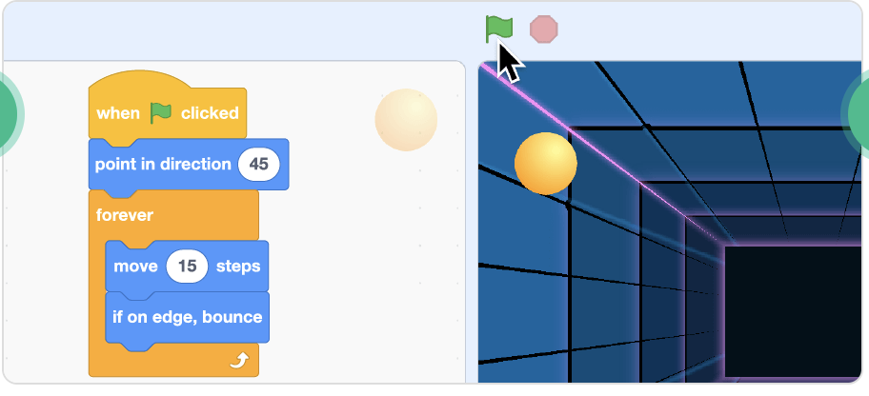
RECAP: Read It and Understand It

Slide 7
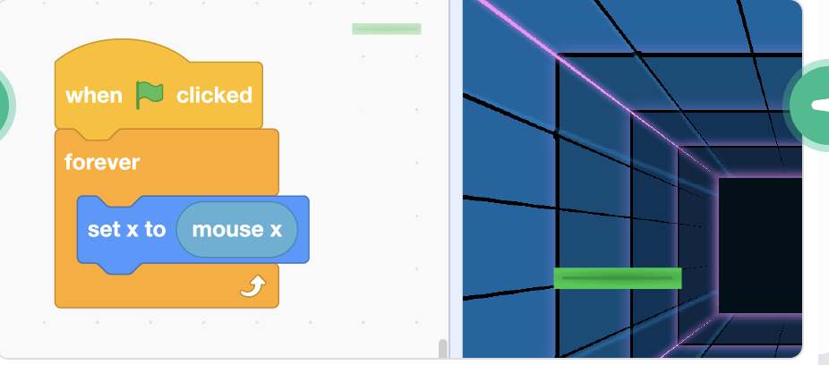
RECAP: Read It and Understand It

Slide 8
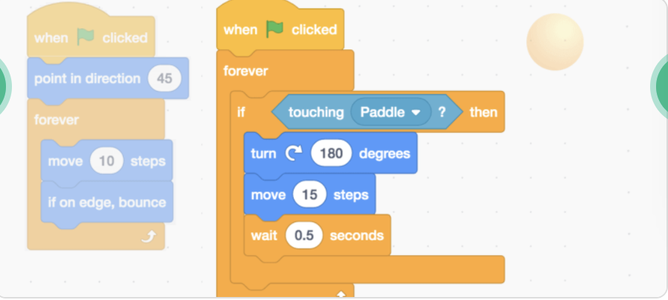
RECAP: Read It and Understand It

Slide 9
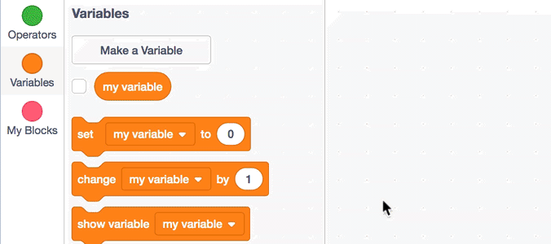
RECAP: Read It and Understand It

Slide 10
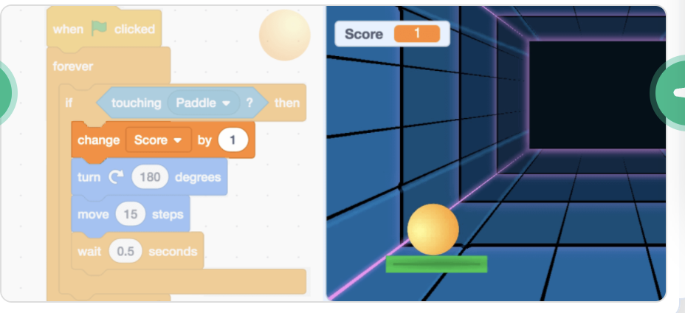
RECAP: Read It and Understand It

Slide 11
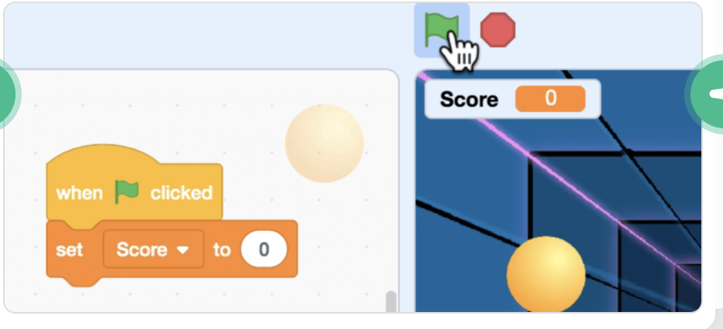
RECAP: Read It and Understand It

Slide 12
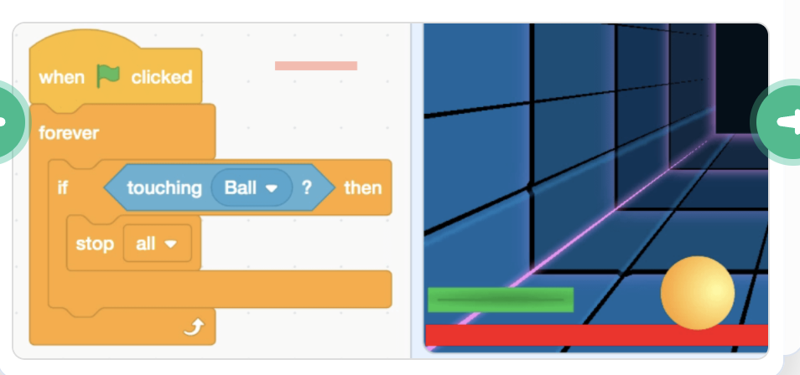
RECAP: Read It and Understand It

Slide 13
RECAP: Pong Game
In your pong game, how did you use the following programming elements?
Object (“sprite”)
Loop
Variable
If / Then Statement
Math Operation

Slide 14
SCRATCH + MICRO:BIT!
You will love this.

Slide 15
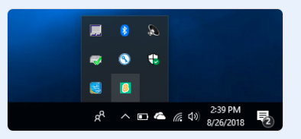
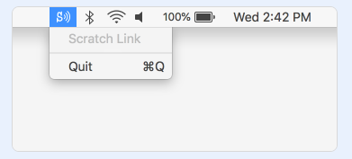
Step 1: Download Scratch Link Application
First, download and install Scratch Link application. Make sure you select correct computer operating system type (!) : https://scratch.mit.edu/microbit
Start Scratch Link. Check to make sure it is running in your toolbar:

Slide 16
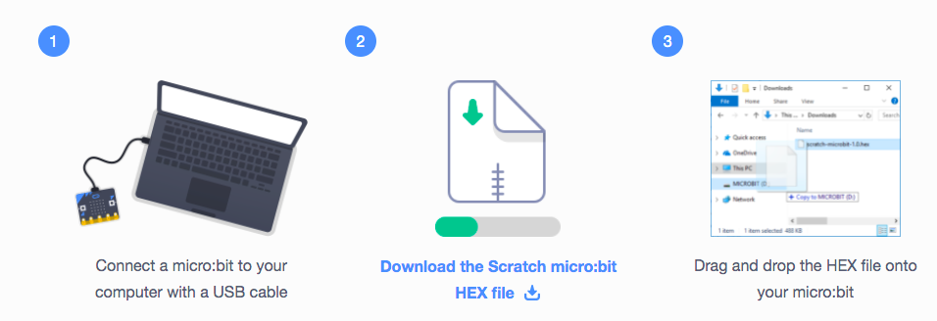
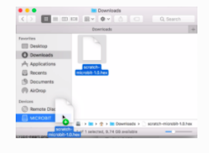
Step 2: Flash Scratch micro:bit HEX file onto micro:bit

Slide 17
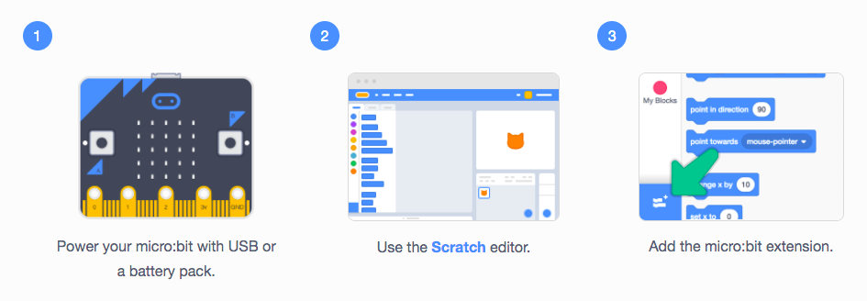
Step 3: Connect micro:bit to Scratch

Slide 18
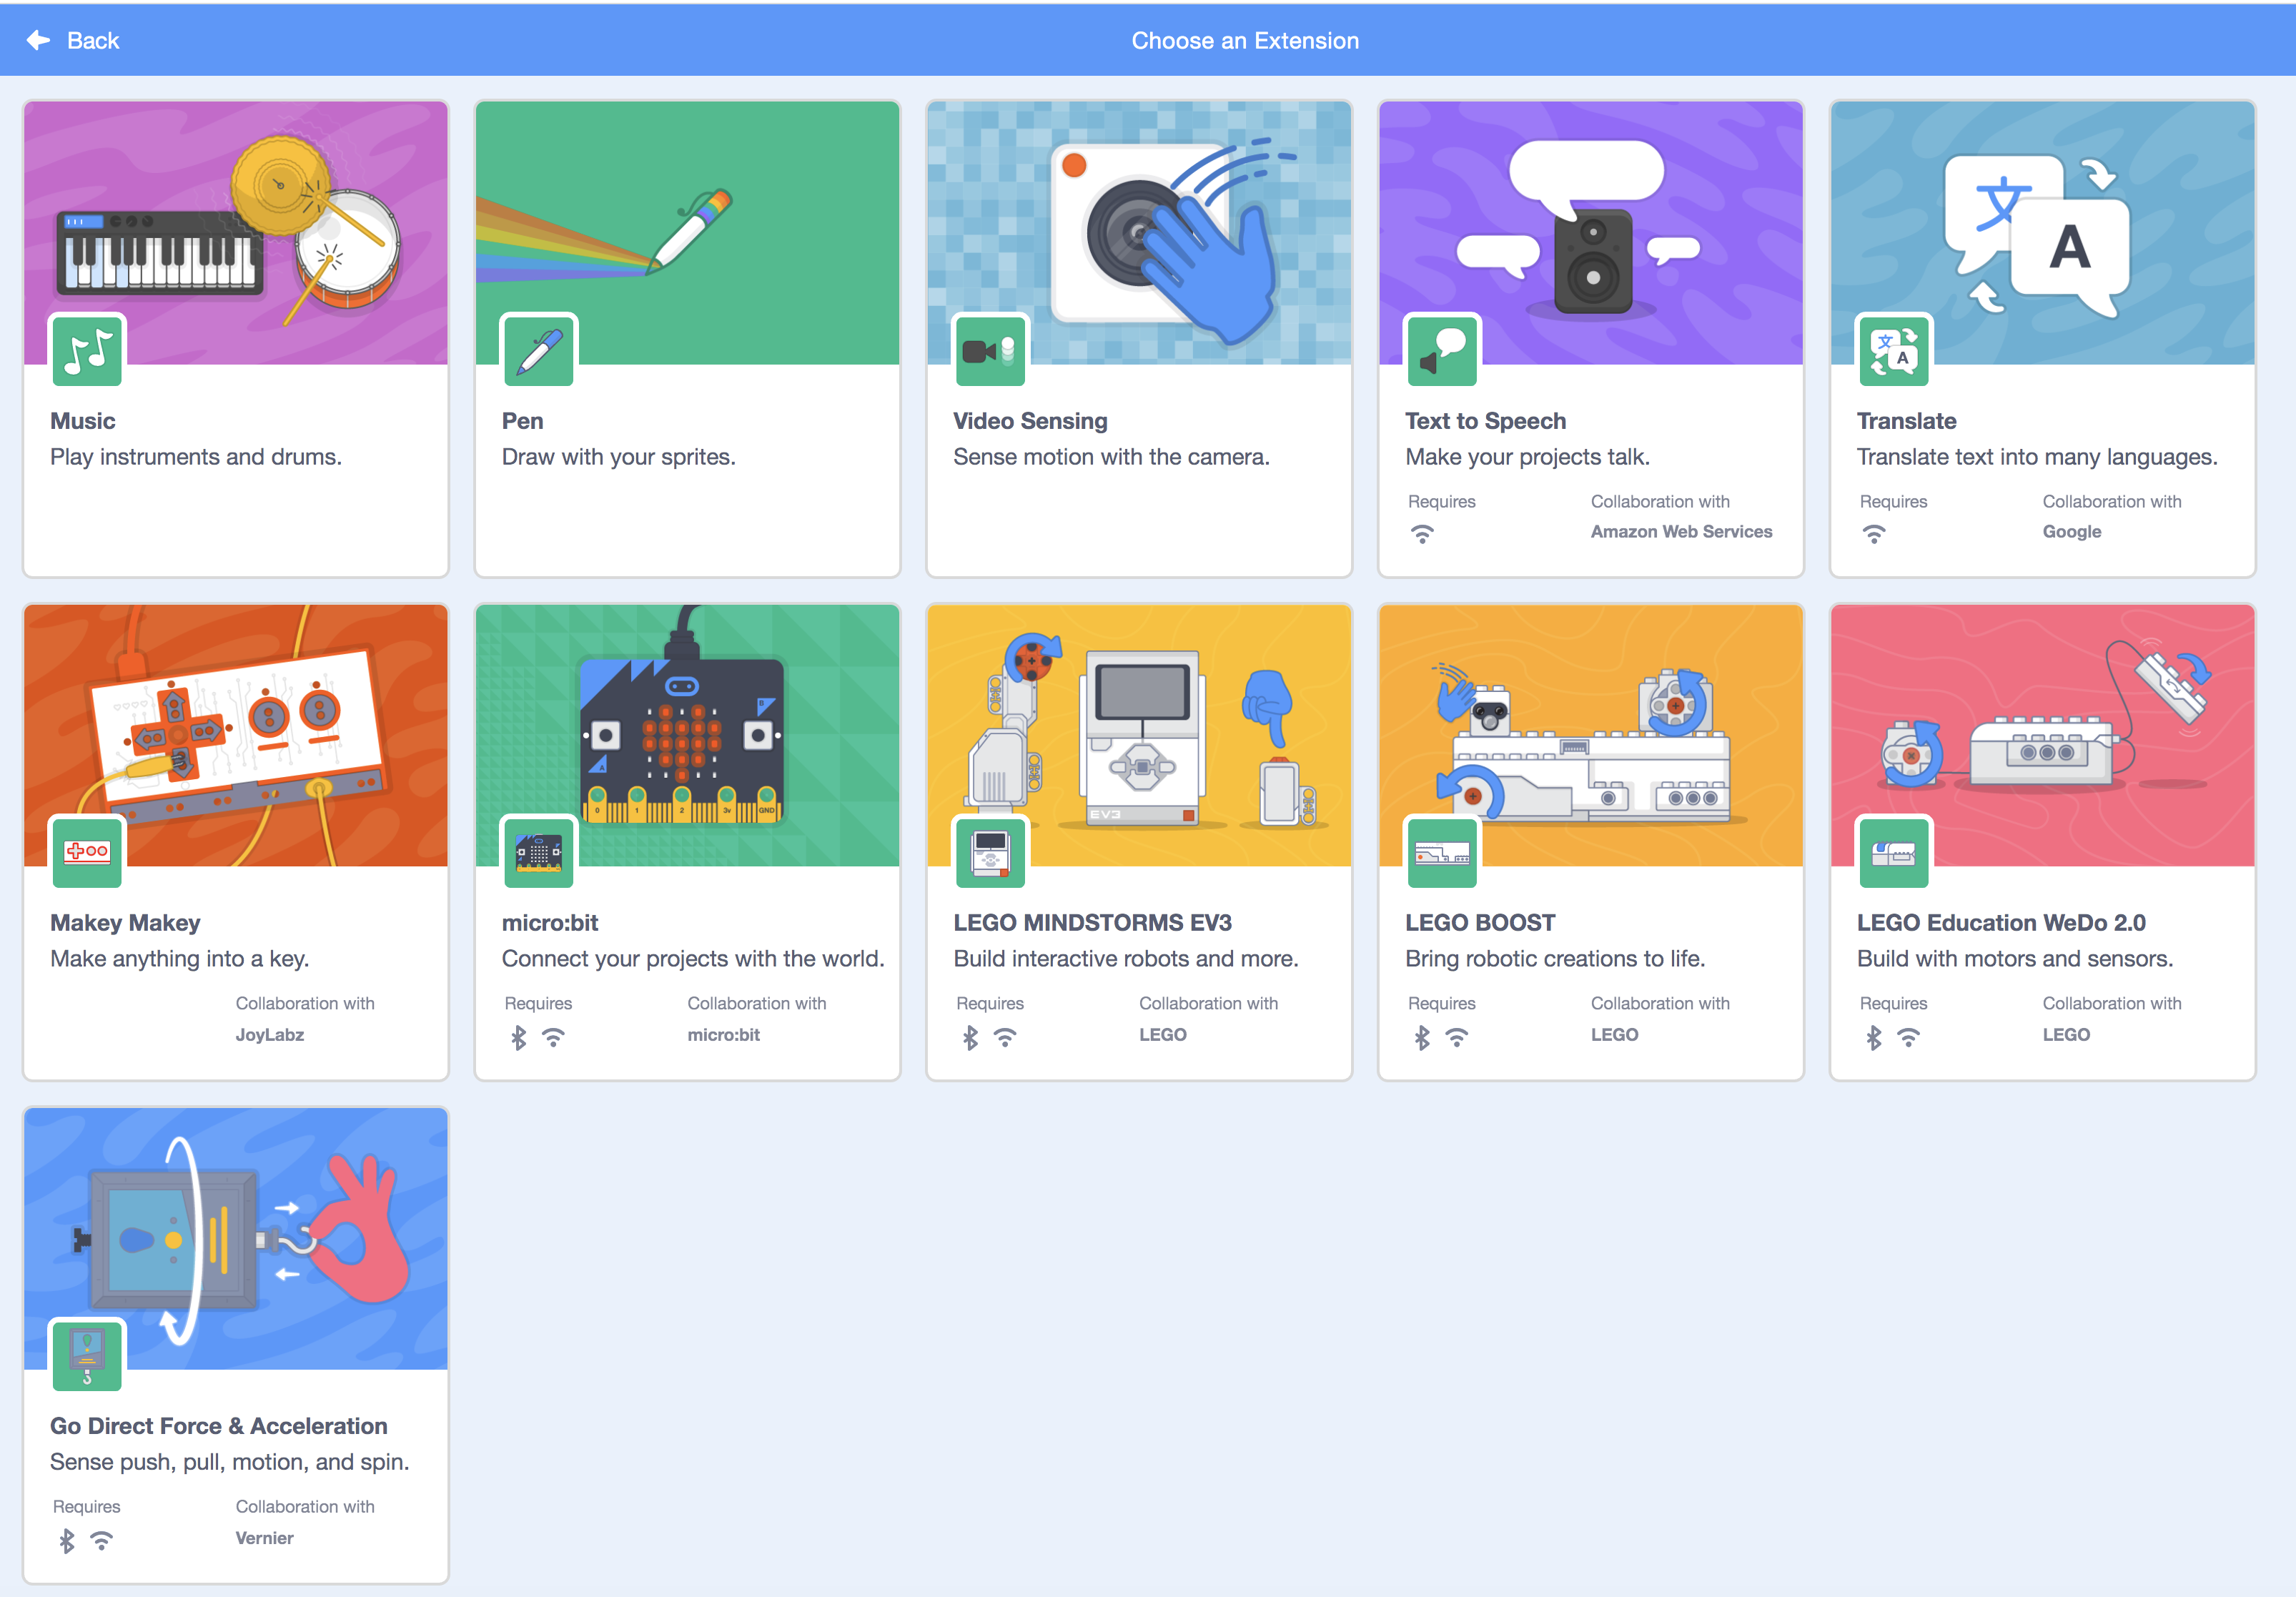

Slide 19
Step 4: Establish Bluetooth Connection
Follow These Directions Carefully….
You will be prompted to select your micro:bit for the wireless connection. You’ll notice each micro:bit has a set of random letters next to it.
Look at your micro:bit. You should see letters scrolling across the screen.
Select the micro:bit connection with the same letters as are shown on your micro:bit’s screen.
Finally, connect and turn on your battery pack, then unplug the USB cable.

Slide 20
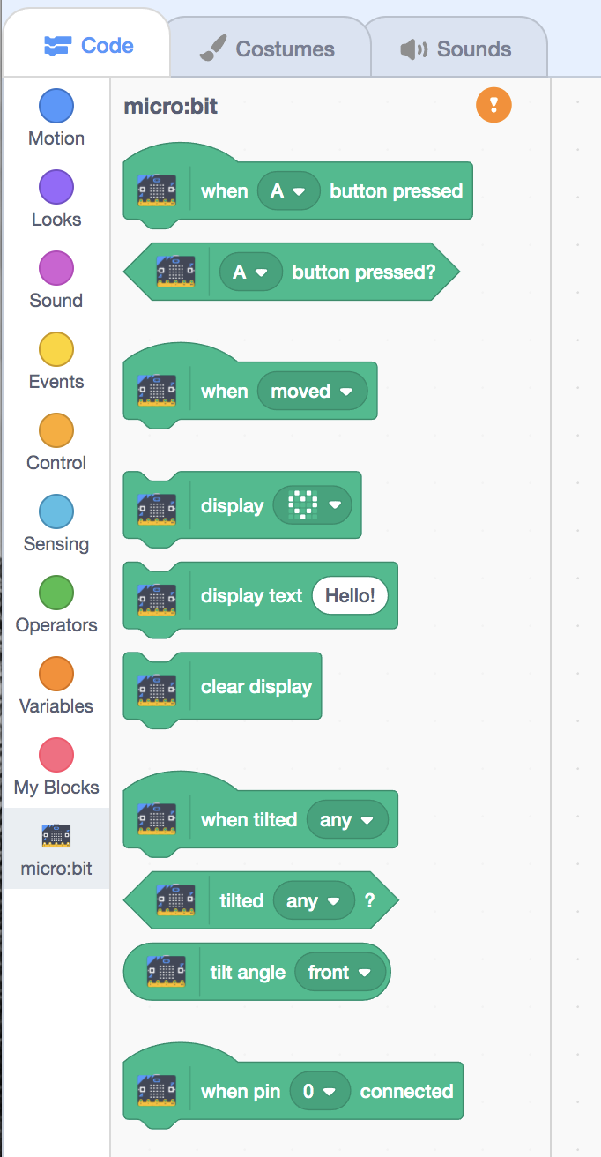

Slide 21
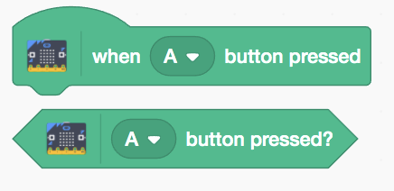

Slide 22
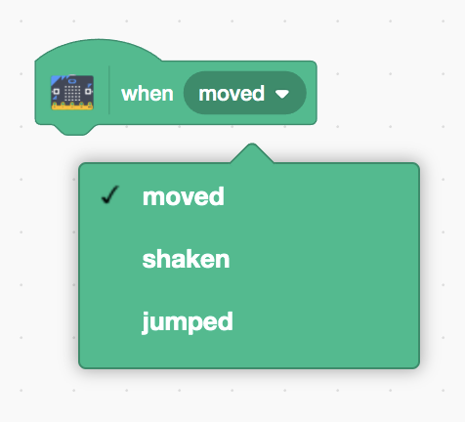

Slide 23
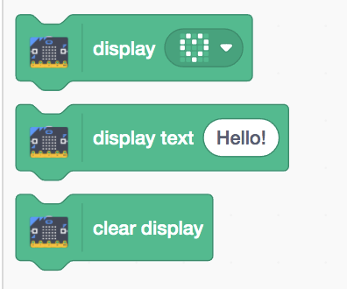

Slide 24
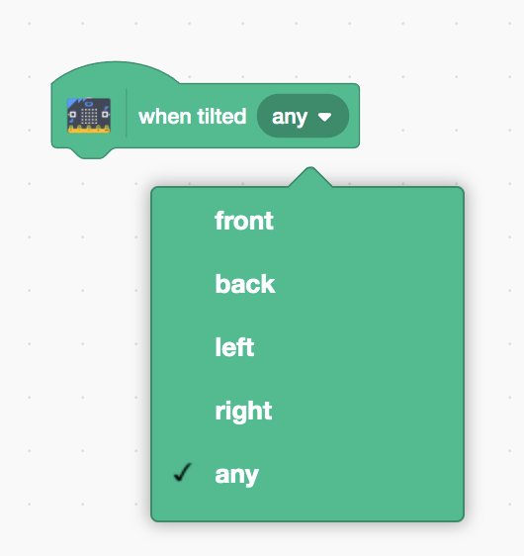

Slide 25
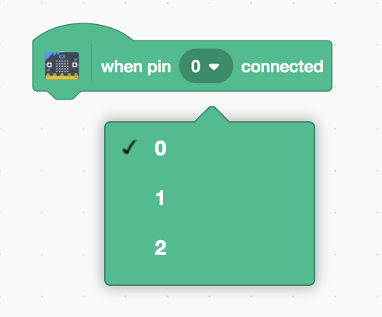

Slide 26
Mini-Challenges
Display a heart on your miro:bit
By pressing A and B, move sprite left or right 10 steps
When shaking micro:bit, change background
If sprite touches another sprite, display a frown on the micro:bit.

Slide 27
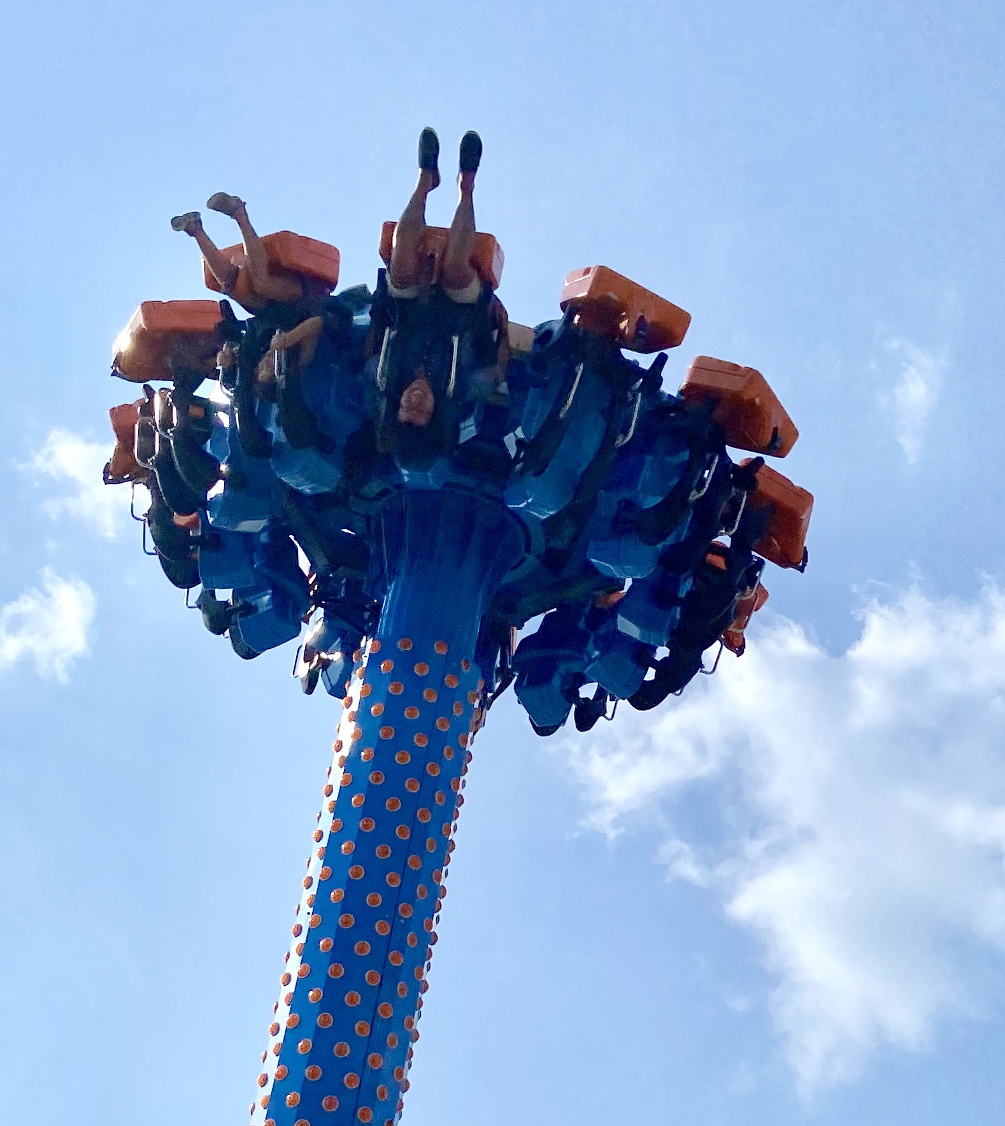
SKILL BADGE
Video Game System
YOUR MISSION
Make a Scratch game that can be controlled with your Micro:bit (!)

Slide 28
Step 1: Plan Your Game Concept (in writing)
Will it be a chase game? Pong? Interactive Story?
Decide on your sprites – how many sprites will you need? What will they do? Will they be interactive, and if so, how?
Decide on your background (how many, what will be in them, when will they be triggered, etc.)
Will you keep score? Will you need a variable?
CHECK-IN!

Slide 29
Step 2: Plan Your Game Story Board (in pictures)
Refine your concept by making a story board. This is like a comic strip that shows what the game will do and will help you program.
Story boxes should include:
What you see when you start the program
How the program looks at different stages
How the end of the program looks.
CHECK-IN

Slide 30
Step 3: Pseudo Code
Start writing your pseudo code for:
Initiate background
Initiate sprites
Initiate any variables you may need
Sprite action
Background action
Actions that affect variables / use of variables (e.g., score board)
CHECK-IN!

Slide 31
Step 4: Code It!
Start turning your pseudo code into Scratch code.
Continuously test and debug.
Try to avoid bells and whistles!

Slide 32
Step 5: Share Your Creation!

Slide 33
TIME TO PUT AWAY OUR COMPUTERS!
Neat and tidy, please!
Let’s leave this beautiful room as lovely as we found it!

Slide 34
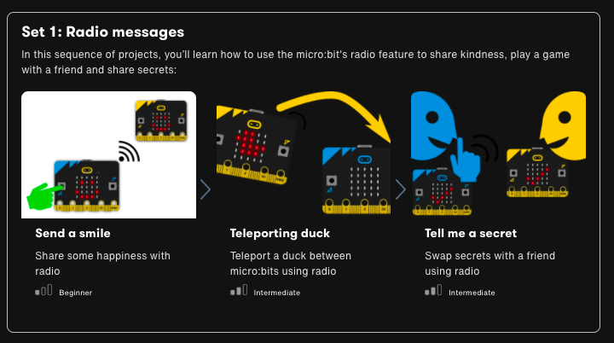
Next Time…

Slide 35

UNTIL NEXT TIME….
MicroMakers!
Slides and Script: Holly Krambeck (learningpython64@gmail.com)
Scratch Link Installation Images and Text:
https://scratch.mit.edu/

